Slide 1
Live Interaction
PRESENTER
Dr. Saba Anees
Assistant Professor in Educational Studies
Department of Education (ITEP)
Central University of Kerala

Slide 2
Outline of the session
After the completion of the session, the audience will be able:
To know about the Poll Everywhere ICT tool
To understand the scope of using Poll Everywhere in teaching & learning
To sign up for Poll Everywhere
To explore the various features like creating MCQs, word cloud, questions & answers, clickable image, survey, open-ended question, competition etc. of Poll Everywhere
To apply Poll Everywhere at different platforms like PPTs and Google Slides

Slide 3
What is Poll Everywhere?
Poll Everywhere is an online interactive polling platform that allows the audience to respond in real-time to questions displayed by the presenter.
It is a web-based polling platform for audience participation. Users create activities through a simple web interface and can embed them directly into PowerPoint or Keynote.
It is also a student engagement tool for K-12 and higher education institutions that allows students and educators to communicate during lectures.

Slide 4
Where to use it in teaching-learning process?
Students can vote on polls through a smartphone, tablet, computer, or text message.
Some ways you can use Poll Everywhere in your class:
Create live polls and quizzes in classes
Take attendance in classes
Collect anonymous responses to questions
Create icebreaker questions
Gauge student interest and opinion
Check for student understanding

Slide 5
Why to use it?
To enhance student engagement in the online classes
It is a student centered approach
It reaffirms outcome based learning
It support formative assessment
Real-time responses can be used for designing further teaching strategy

Slide 6
How to use it?
Sign up
Design your activities
Activate/deactivate your activities
Share/download the responses
Invite other presenters
Incorporate poll in your presentations through PPT/google slides

Slide 7
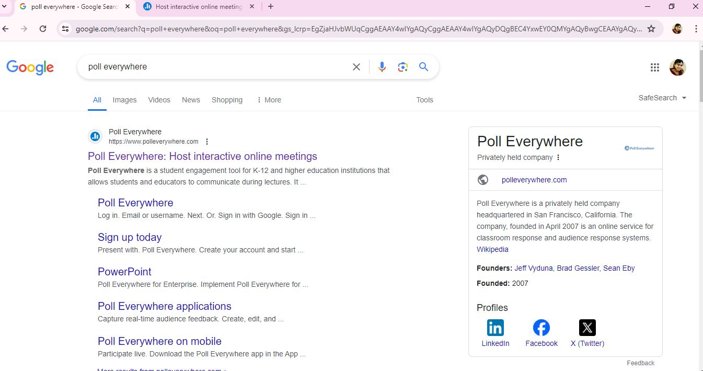

Slide 8
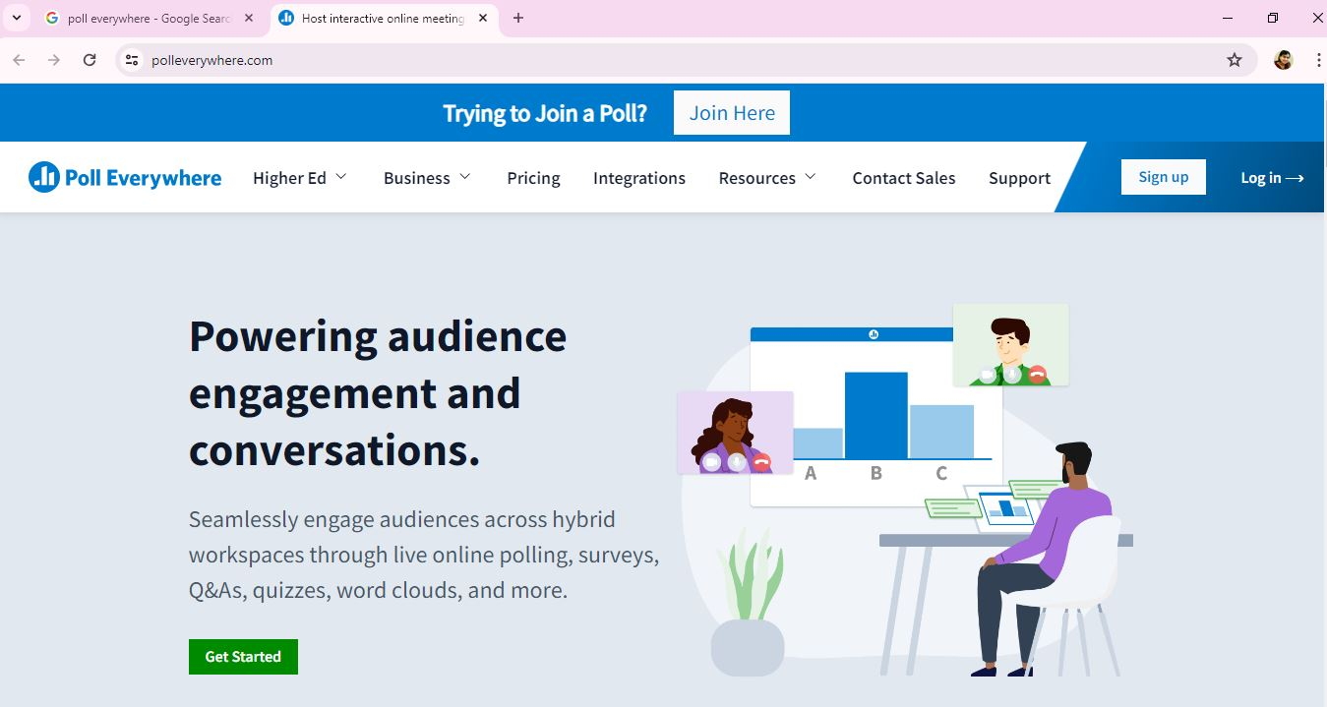

Slide 9
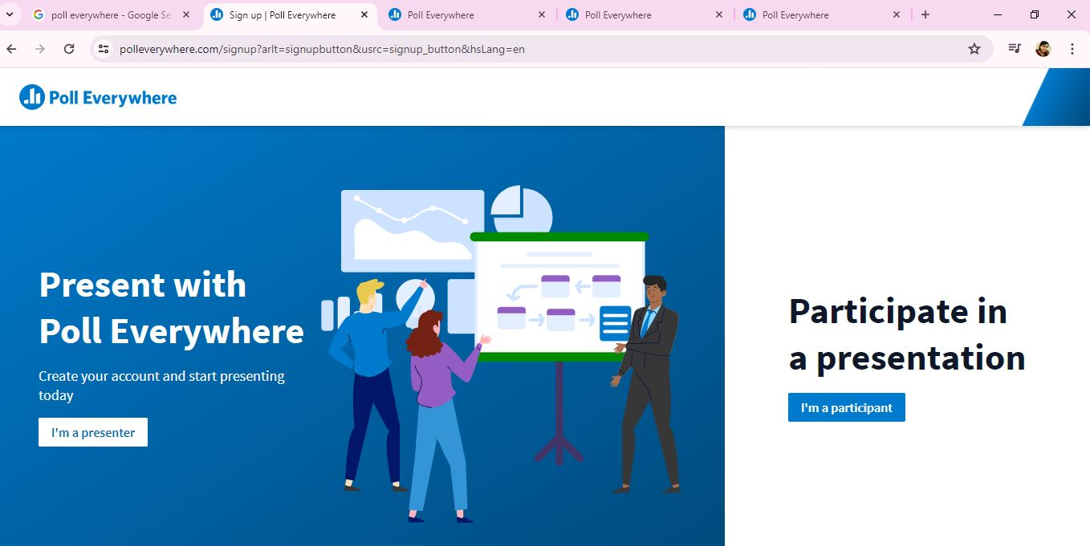

Slide 10
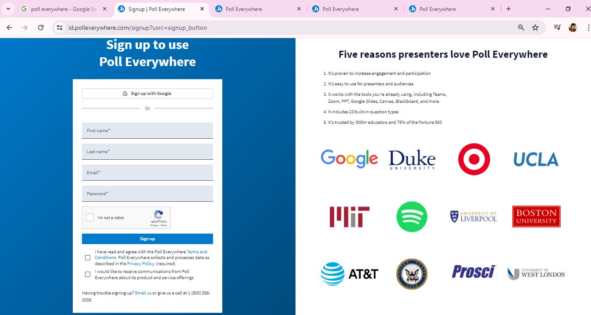

Slide 11
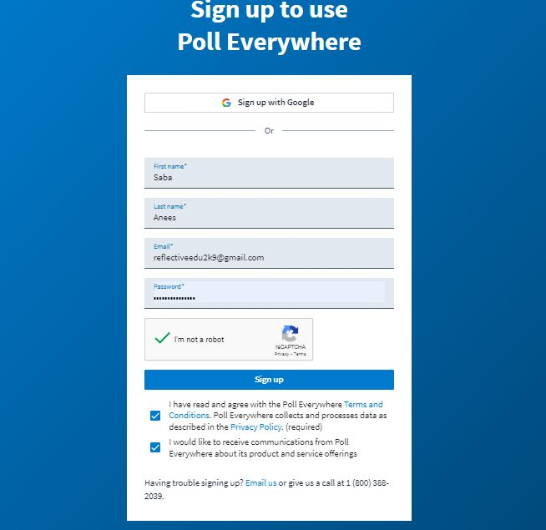

Slide 12
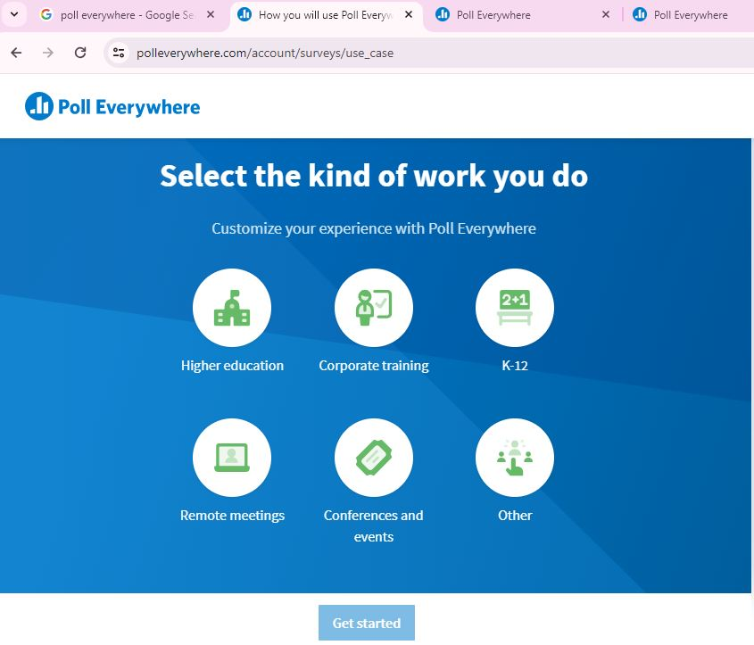

Slide 13
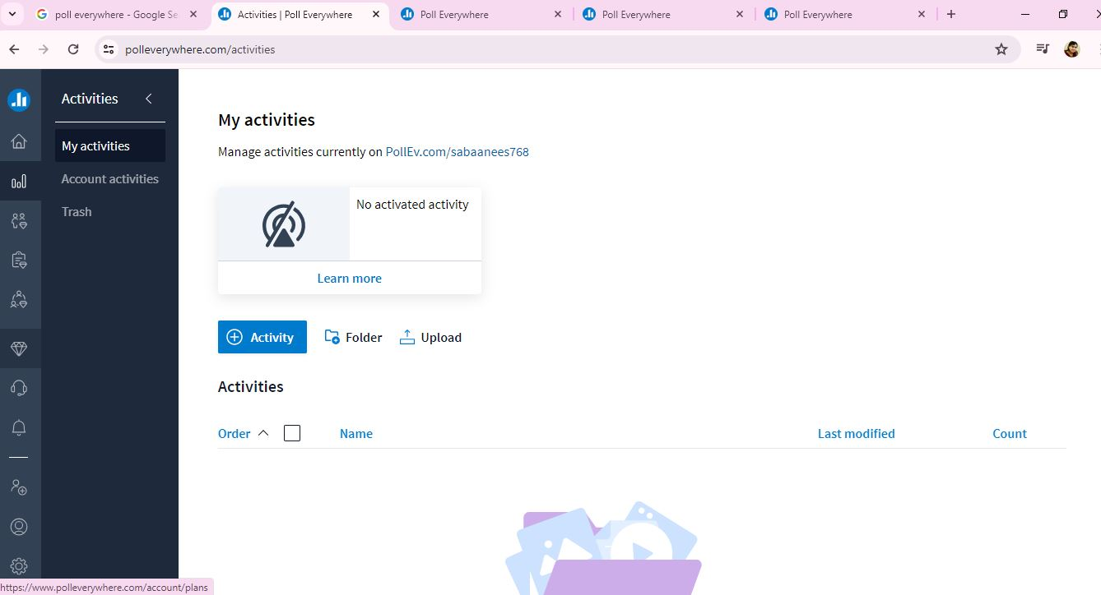

Slide 14
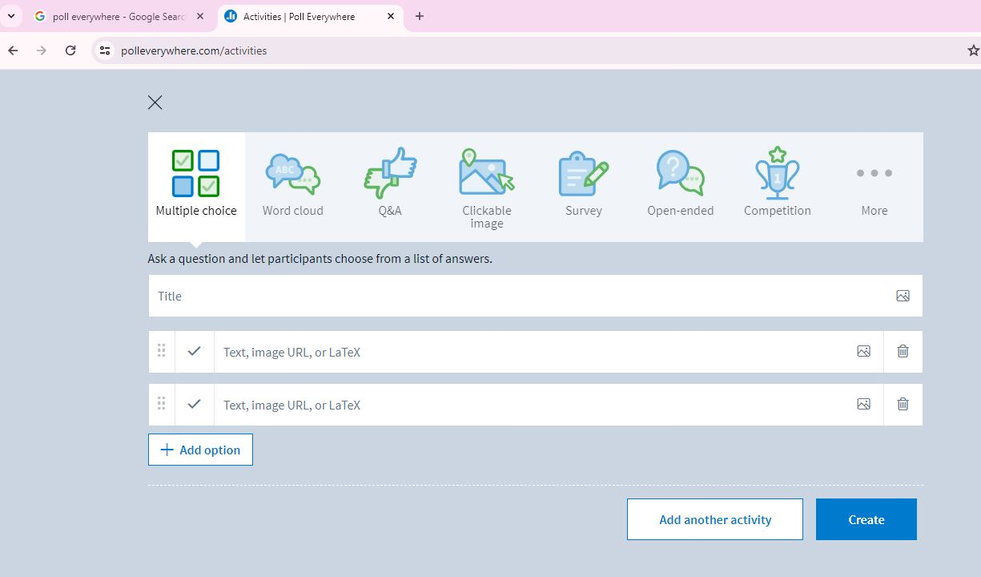

Slide 15
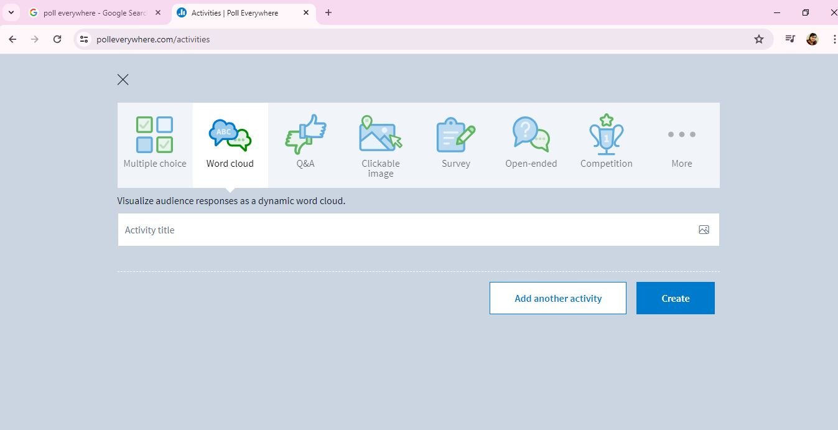
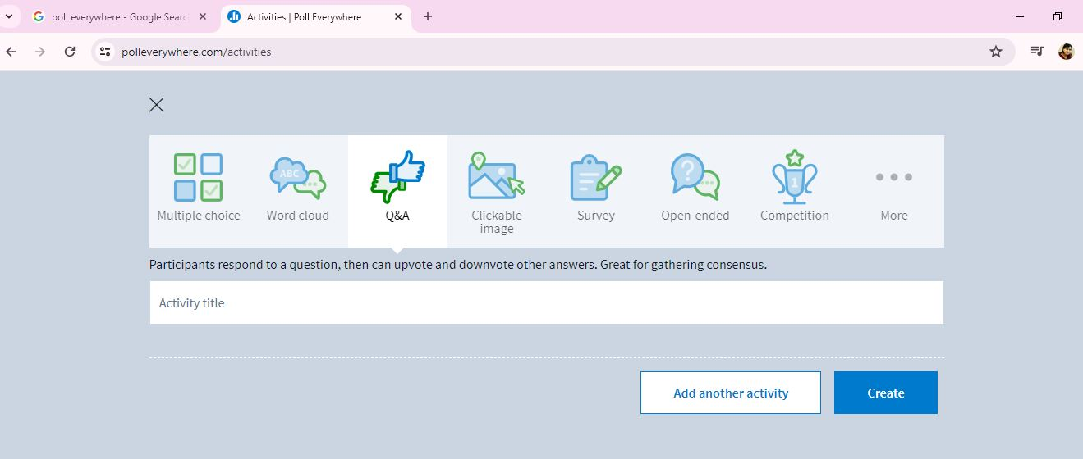

Slide 16
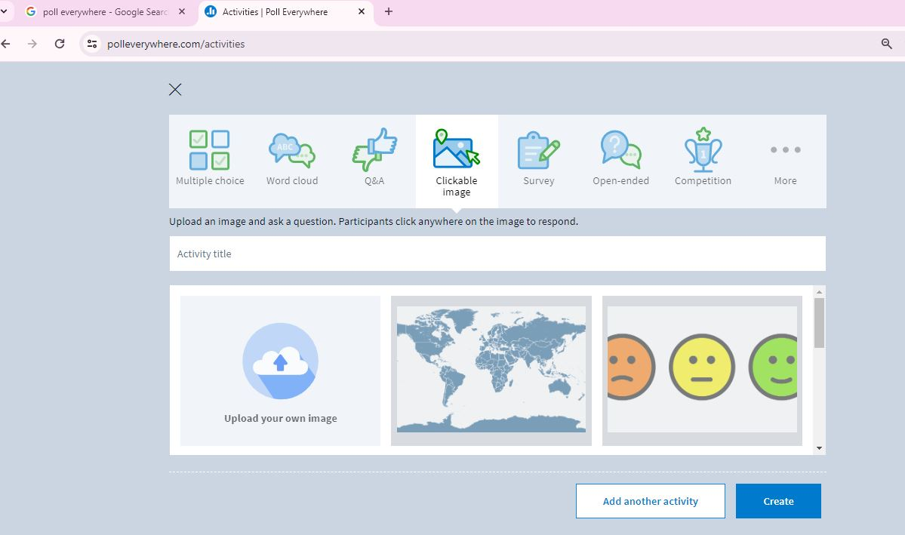
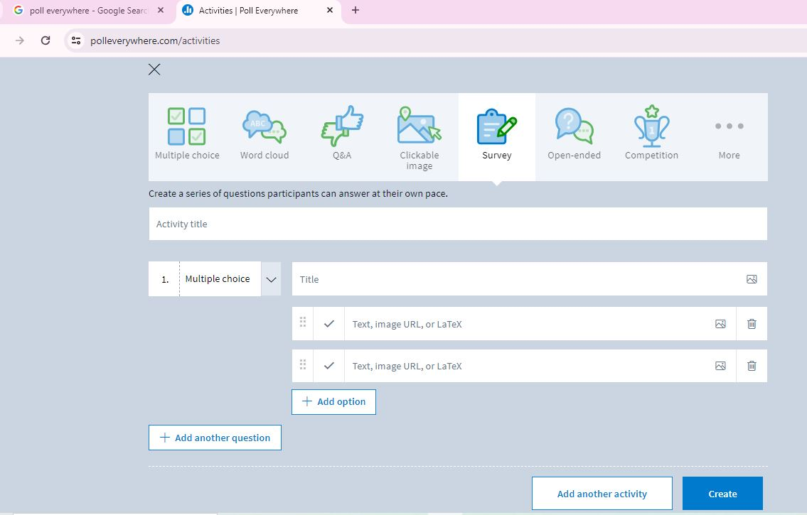

Slide 17
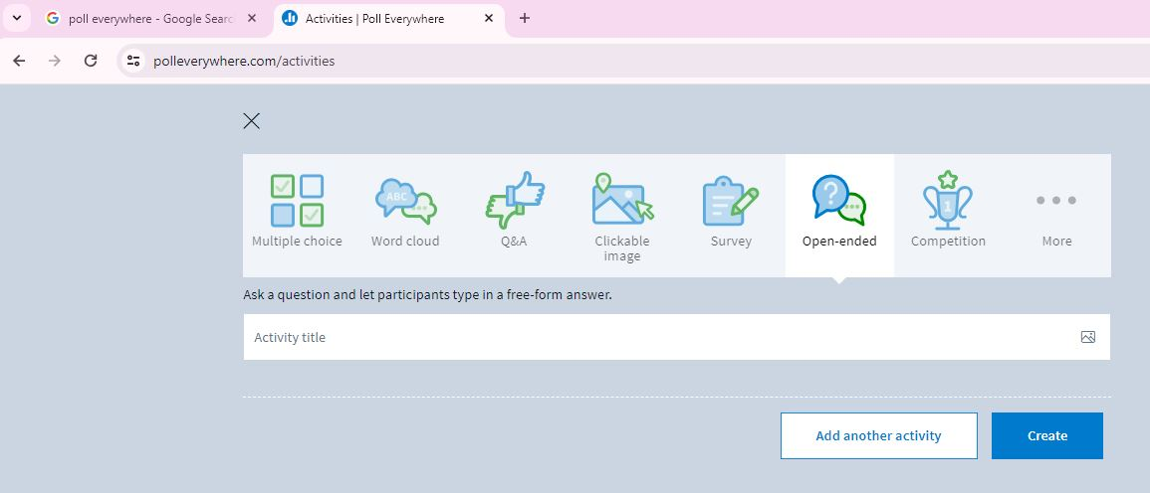
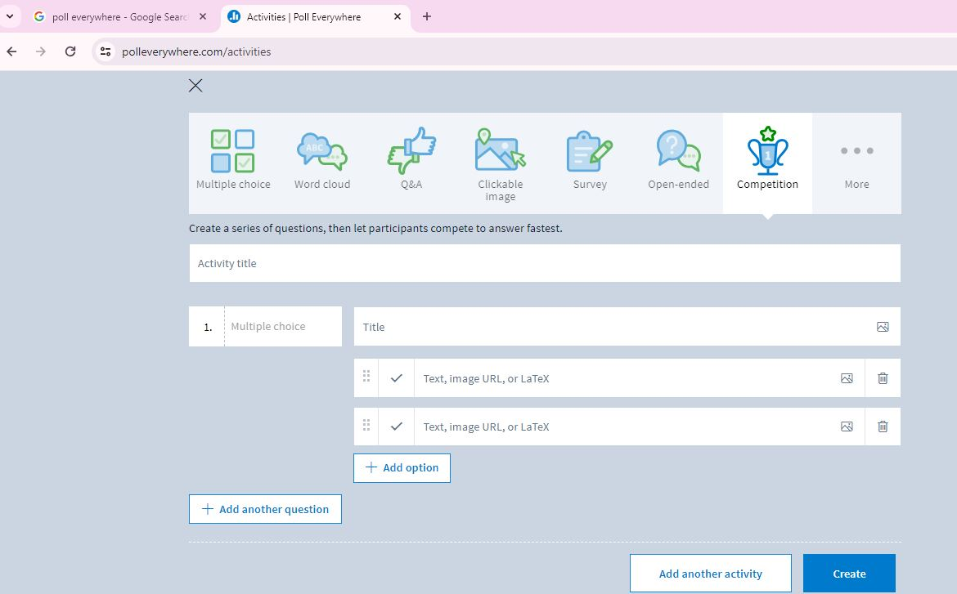

Slide 18
